Slide 1
HIGHLIGHTING THE SIMPLILEARN ADVANTAGE
CAMPAIGN KICK OFF DECK ◉ Q4 2018 ◉ Tegan Silanskas

Slide 2
AGENDA
1
About: The Why, Who and What
2
Key Messaging
3
Objective and Overview
4
Market Insights and Goals

Slide 3
About: The Why, Who and What

Slide 4
WHY: Why Blended Learning and Why Now?
Competition

Slide 5
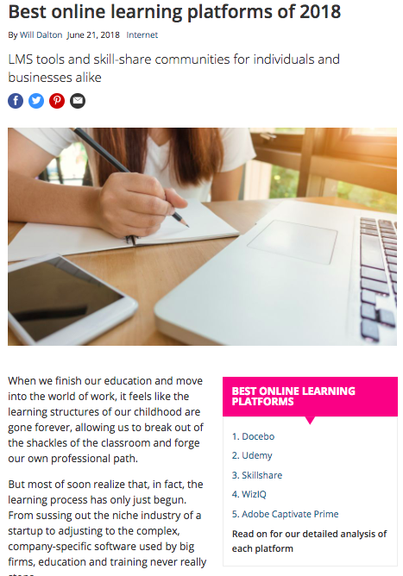
At Simplilearn we offer enterprise solutions but you wouldn’t know that if you looked for top enterprise learning platforms. We have nothing that makes us stand out in the market which is NOT because we don’t have anything but because we haven’t adequately spread the news of why we are great.

Slide 6
Blended Learning has been our best kept secret but now, it’s the key to unlocking our market potential.

Slide 7
Blended Learning Audience
Blended Learning is the Simplilearn Advantage.
Primary
Learning and Development
This is the primary audience. L&D leaders who are dedicated to finding learning for an organization.
Human Resources and Management
The secondary audience are those who are tasked with finding enterprise solutions for a team or company but it is not their primary job role.
Secondary
The last audience is more of a trickle down effect of this campaign, highlighting professionals seeking to learn in the market and potentially leading to the primary of secondary audience.
Individual Learners
Tertiary
DEPT. 4

Slide 8
Awareness
Evaluation
Justification
Education
Purchase
Funnel Alignment

Slide 9
Opportunity
https://www2.deloitte.com/insights/us/en/focus/human-capital-trends/2016/fostering-culture-of-learning-for-employees.html

Slide 10
Key Messaging

Slide 11
Defining Blended Learning
We are highly focused on skills for a changing digital world. Simplilearn’s blended learning combines the convenience of self-paced online training, the personal attention of instructor-led live virtual classroom instruction and hands-on learning via projects and labs.

Slide 12
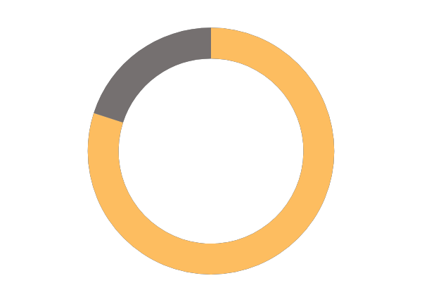
Blended Learning Drives Outcomes
Pre-Assessment
Learning Engagements
Hands on, real world project based learning
Certification
Engaging self-learning videos
Assignments
85%
Course Completion
Mentor guided class
Assess your learners and optimize the curriculum
Hands-on Labs
Mentorship
80%
Final assessment exam score
Quizzes and Practice Tests
Real world scenarios
Project Submission
and Evaluation
Capstone Industry Projects
Additional reading resources
Practice lab/projects
Global Teaching Assistants and 24/7 learning support
Mobile On-the-Go Learning
Notes:
[no change]

Slide 13
Key Points in the Blended Learning Message
Simplilearn Blended Learning provides advantages over simple online self paced learning partners or classroom only training partners.
Blended Learning gets results. It has proven outcomes in upskilling, onboarding and efficiently training large teams.
The Simplilearn Advantage includes custom learning paths tailored to each client based on their needs.

Slide 14
Messaging Points to Remember:
Key Point – Simplilearn’s Blended Learning Drives Outcomes
Phrase Avoidance – High-touch learning, customized learning, low-touch

Slide 15
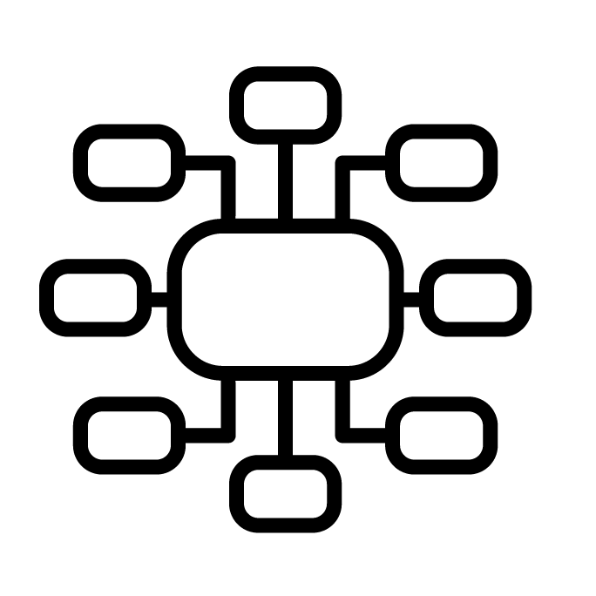
Campaign Phases
The phases of the campaign are as follows
AWARENESS
AWARENESS
January 9-30, 2019
EDUCATION
January 31-February 27, 2019
EVALUATION
February 28-March 22, 2019
EVALUATION
EDUCATION

Slide 16
AWARENESS
AWARENESS
What is blended learning? Simplilearn’s Outcome Centric Training
January 9-30, 2019
Why Blended Learning is the Fastest Way to Close the Digital Skills Gap
Blended Learning: A Modality of Advancement

Slide 17
EDUCATION
EDUCATION
AWARENESS
Why does Blended Learning Matter? What Blended Learning Means for You
January 31 to February 27, 2019
Why Blended Learning is the Fastest Way to Close the Digital Skills Gap
Upskilling Strengthens the Human Link in the Corporate Supply Chain
Has eLearning Killed the Learning Cone?

Slide 18
EVALUATION
EVALUATION
AWARENESS
Investing in Blended Learning at Simplilearn
February 28 to March 22, 2019
Why Blended Learning is the Fastest Way to Close the Digital Skills Gap
Blended Learning Speeds Employee Reskilling
Blended Learning End of Year Wrap Up
Five Reasons why Blended Learning is Ideal for Corporate Training

Slide 19
Metrics

